Slide 1
Project Lima
Nikita Shaina Patel
Ben Strick
Joshua Roberts
Eric Sun
Xiaowei Sun
Jin Sun
Connor O’Brien

Slide 2
Our Idea
Northwestern-themed Card Game
Two player, turn based strategy mayhem
Multiplayer chat mechanism
Online peer-to-peer gaming action

Slide 3
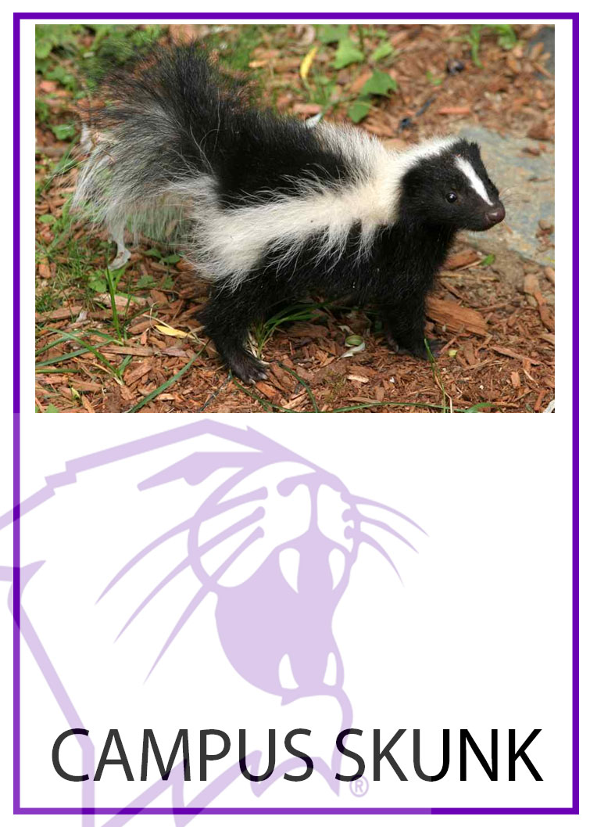

Northwestern-Themed?? A few of our cards…

Slide 4
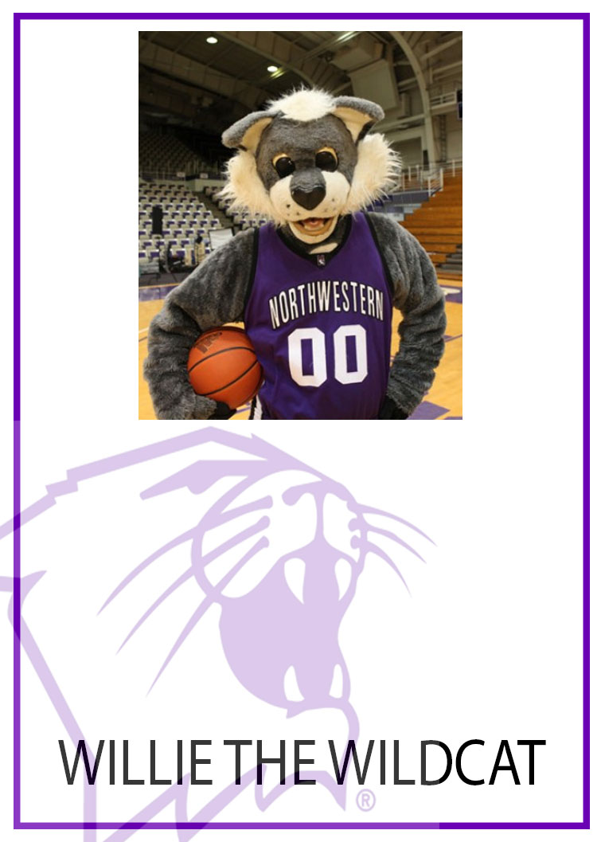
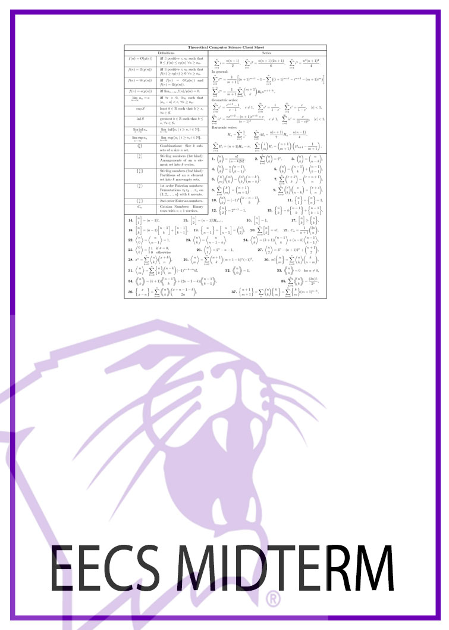
Cards cont.

Slide 5

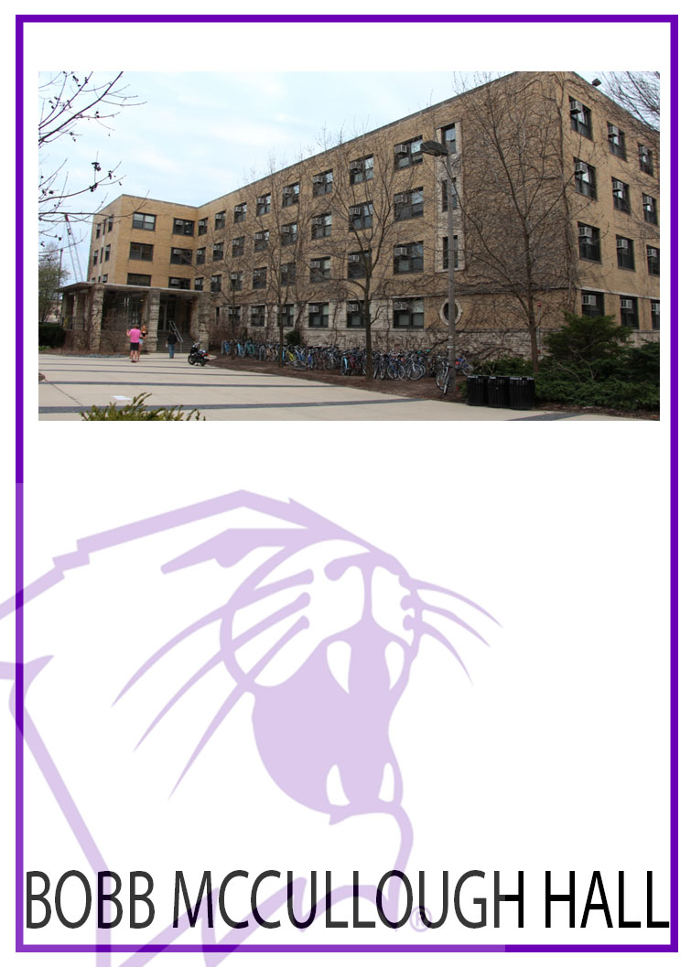
Cards cont.

Slide 6

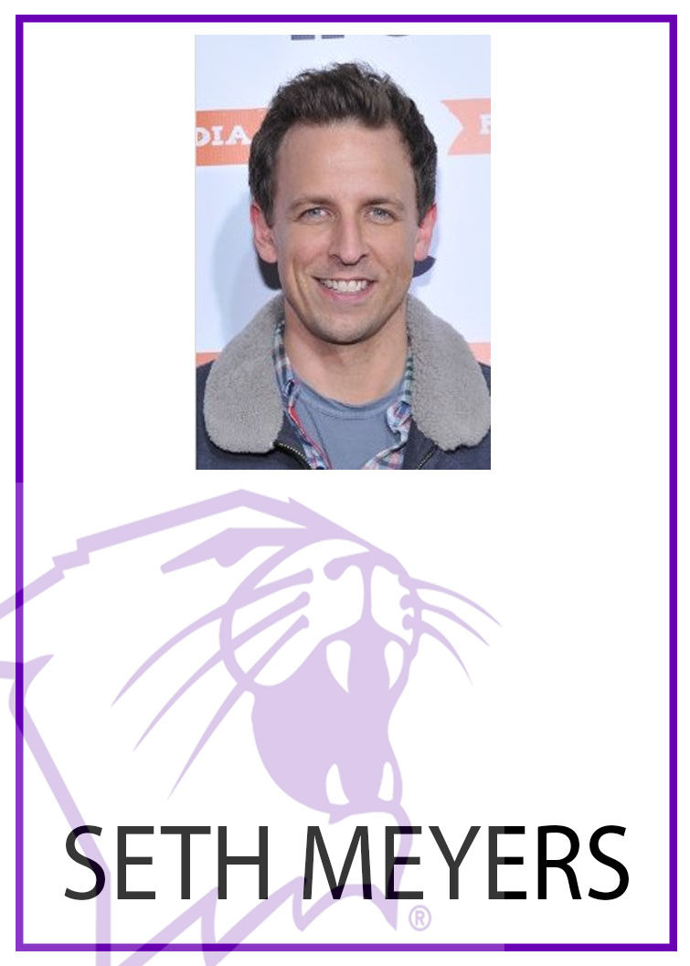
Cards cont.

Slide 7
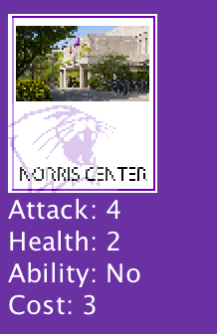
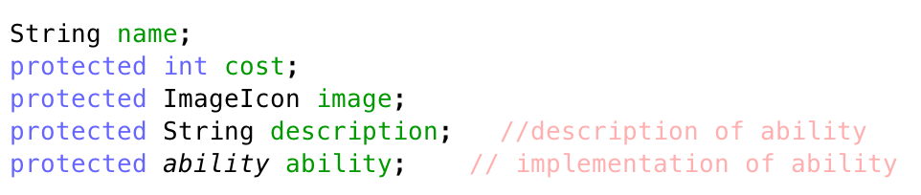
What is a Card?
Cost
Health
Attack
Ability
Description
Name

Slide 8
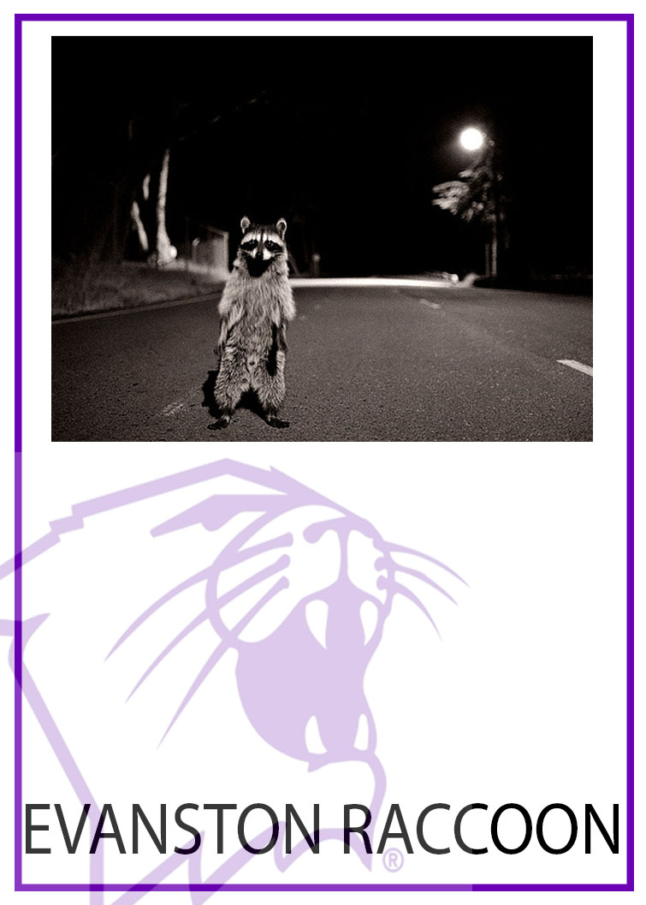
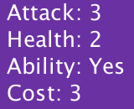
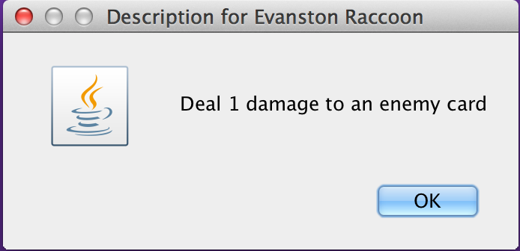
Abilities

Slide 9
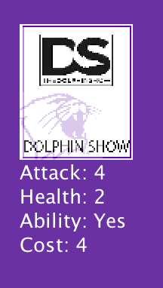
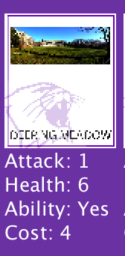
Card Interaction
When a card attacks another card, health values are exchanged based on attack
Attacks
RESULT
DS
Attack: 4
Health: 1
DM
Attack: 1
Health: 2

Slide 10
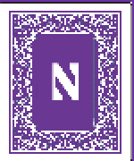
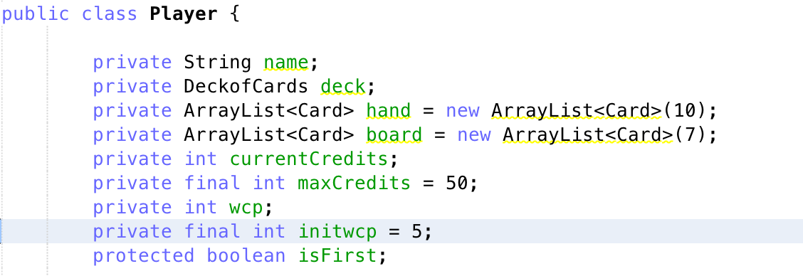
The Player
Total Health (in Credits)
Wildcat Points (resource)

Slide 11
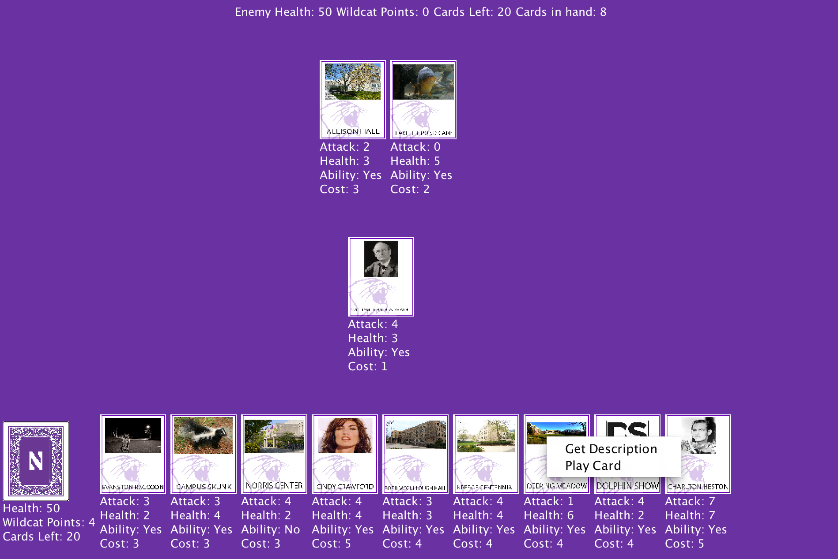
Game Board

Slide 12
Chat Interface

Slide 13
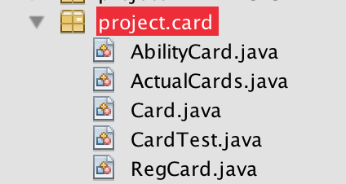
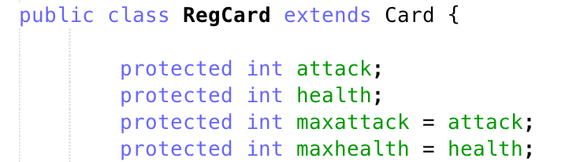
Card Hierarchy

Slide 14
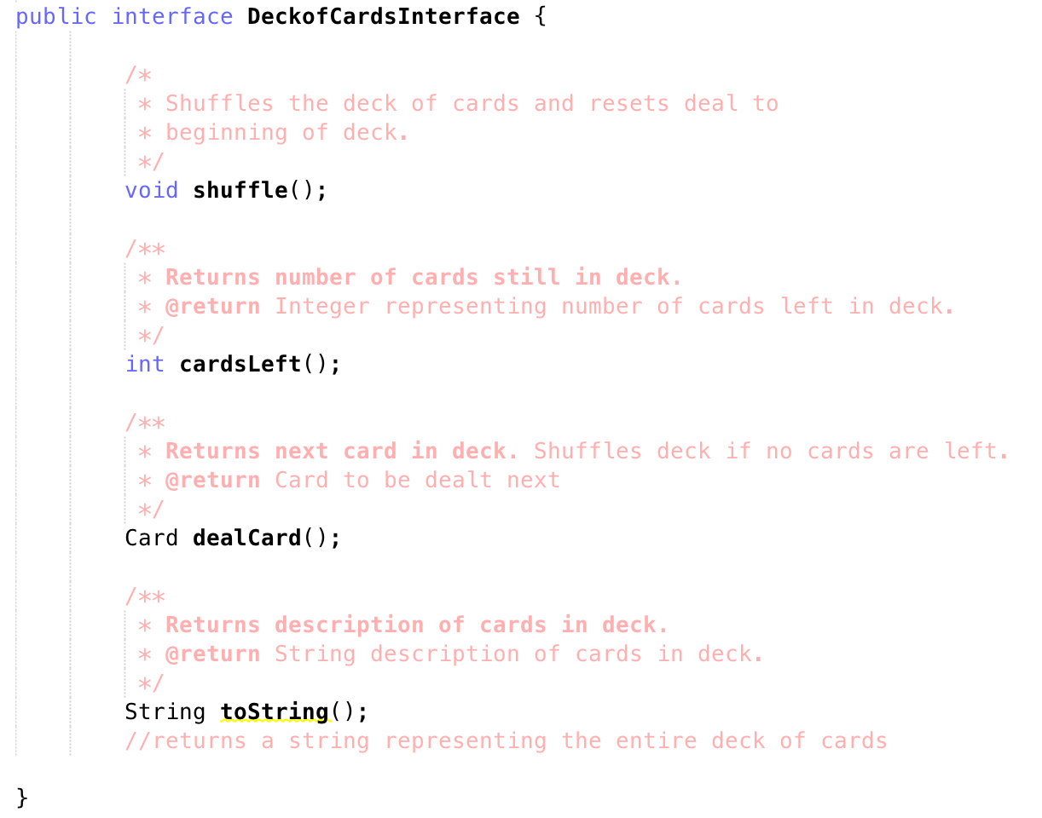
Deck

